Slide 1

Lecture 12:
Convolutional Neural Networks
[LeNet-5, LeCun 1980]

Slide 2
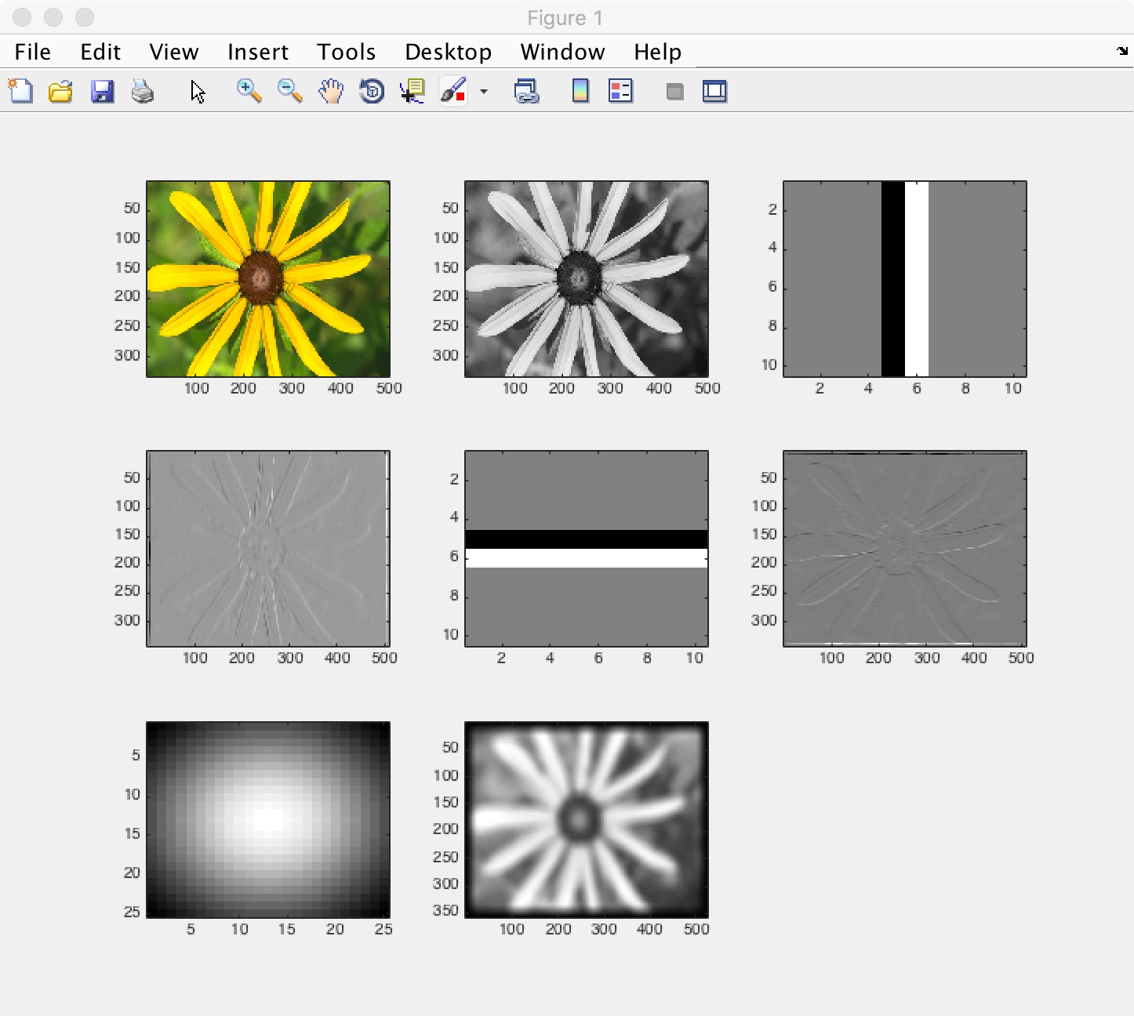
Convolution demo in Matlab.

Slide 3
Convolution Layer
32x32x3 image
32
height
32
width
3
depth

Slide 4
Convolution Layer
32x32x3 image
5x5x3 filter
32
Convolve the filter with the image
i.e. “slide over the image spatially, computing dot products”
32
3

Slide 5
Convolution Layer
Filters always have depth equal to the full depth of the input volume
32x32x3 image
5x5x3 filter
32
Convolve the filter with the image
i.e. “slide over the image spatially, computing dot products”
32
3

Slide 6

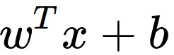
Convolution Layer
32x32x3 image
5x5x3 filter
32
1 number:
the result of taking a dot product between the filter and a small 5x5x3 chunk of the image
(i.e. 5*5*3 = 75-dimensional dot product + bias)
32
3

Slide 7
Convolution Layer
activation map
32x32x3 image
5x5x3 filter
32
28
convolve (slide) over all spatial locations
32
28
3
1

Slide 8
consider a second, green filter
Convolution Layer
32x32x3 image
5x5x3 filter
activation maps
32
28
convolve (slide) over all spatial locations
32
28
3
1

Slide 9
For example, if we had 6 5x5 filters, we’ll get 6 separate activation maps:
activation maps
32
28
Convolution Layer
32
28
3
6
We stack these up to get a “new image” of size 28x28x6!

Slide 10
Preview: ConvNet is a sequence of Convolution Layers, interspersed with activation functions
32
28
CONV,
ReLU
e.g. 6 5x5x3 filters
32
28
3
6

Slide 11
Preview: ConvNet is a sequence of Convolutional Layers, interspersed with activation functions
32
28
24
….
CONV,
ReLU
e.g. 6 5x5x3 filters
CONV,
ReLU
e.g. 10 5x5x6 filters
CONV,
ReLU
32
28
24
3
6
10

Slide 12

Preview
[From recent Yann LeCun slides]

Slide 13
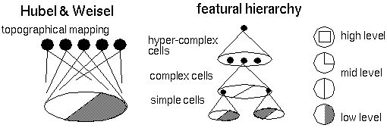
Preview
[From recent Yann LeCun slides]

Slide 14
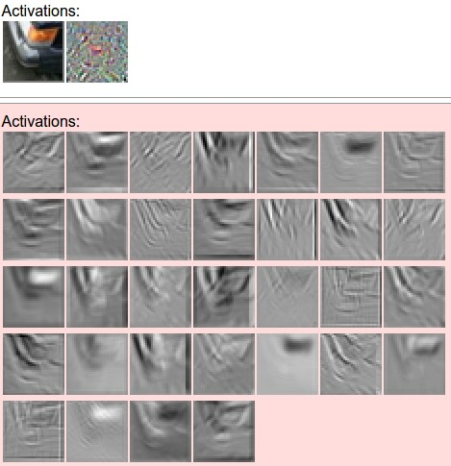
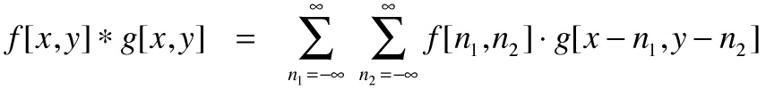
one filter =>
one activation map
example 5x5 filters
(32 total)
We call the layer convolutional because it is related to convolution of two signals:
elementwise multiplication and sum of a filter and the signal (image)

Slide 15

preview:

Slide 16
A closer look at spatial dimensions:
activation map
32x32x3 image
5x5x3 filter
32
28
convolve (slide) over all spatial locations
32
28
3
1

Slide 17
A closer look at spatial dimensions:
7
7x7 input (spatially)
assume 3x3 filter
7

Slide 18
A closer look at spatial dimensions:
7
7x7 input (spatially)
assume 3x3 filter
7

Slide 19
A closer look at spatial dimensions:
7
7x7 input (spatially)
assume 3x3 filter
7

Slide 20
A closer look at spatial dimensions:
7
7x7 input (spatially)
assume 3x3 filter
7

Slide 21
A closer look at spatial dimensions:
7
7x7 input (spatially)
assume 3x3 filter
=> 5x5 output
7

Slide 22
A closer look at spatial dimensions:
7
7x7 input (spatially)
assume 3x3 filter
applied with stride 2
7

Slide 23
A closer look at spatial dimensions:
7
7x7 input (spatially)
assume 3x3 filter
applied with stride 2
7

Slide 24
A closer look at spatial dimensions:
7
7x7 input (spatially)
assume 3x3 filter
applied with stride 2
=> 3x3 output!
7

Slide 25
A closer look at spatial dimensions:
7
7x7 input (spatially)
assume 3x3 filter
applied with stride 3?
7

Slide 26
A closer look at spatial dimensions:
7
7x7 input (spatially)
assume 3x3 filter
applied with stride 3?
7
doesn’t fit!
cannot apply 3x3 filter on 7x7 input with stride 3.

Slide 27
N
Output size:
(N - F) / stride + 1
e.g. N = 7, F = 3:
stride 1 => (7 - 3)/1 + 1 = 5
stride 2 => (7 - 3)/2 + 1 = 3
stride 3 => (7 - 3)/3 + 1 = 2.33 :\
F
N
F

Slide 28
In practice: Common to zero pad the border
0 | 0 | 0 | 0 | 0 | 0
0
0
0
0
e.g. input 7x7
3x3 filter, applied with stride 1
pad with 1 pixel border => what is the output?
(recall:)
(N - F) / stride + 1

Slide 29
In practice: Common to zero pad the border
0 | 0 | 0 | 0 | 0 | 0
0
0
0
0
e.g. input 7x7
3x3 filter, applied with stride 1
pad with 1 pixel border => what is the output?
7x7 output!

Slide 30
In practice: Common to zero pad the border
0 | 0 | 0 | 0 | 0 | 0
0
0
0
0
e.g. input 7x7
3x3 filter, applied with stride 1
pad with 1 pixel border => what is the output?
7x7 output!
in general, common to see CONV layers with stride 1, filters of size FxF, and zero-padding with (F-1)/2. (will preserve size spatially)
e.g. F = 3 => zero pad with 1
F = 5 => zero pad with 2
F = 7 => zero pad with 3

Slide 31
Remember back to…
E.g. 32x32 input convolved repeatedly with 5x5 filters shrinks volumes spatially!
(32 -> 28 -> 24 ...). Shrinking too fast is not good, doesn’t work well.
32
28
24
….
CONV,
ReLU
e.g. 6 5x5x3 filters
CONV,
ReLU
e.g. 10 5x5x6 filters
CONV,
ReLU
32
28
24
3
6
10

Slide 32
Examples time:
Input volume: 32x32x3
10 5x5 filters with stride 1, pad 2
Output volume size: ?

Slide 33
Examples time:
Input volume: 32x32x3
10 5x5 filters with stride 1, pad 2
Output volume size:
(32+2*2-5)/1+1 = 32 spatially, so
32x32x10

Slide 34
Examples time:
Input volume: 32x32x3
10 5x5 filters with stride 1, pad 2
Number of parameters in this layer?

Slide 35
Examples time:
Input volume: 32x32x3
10 5x5 filters with stride 1, pad 2
Number of parameters in this layer?
each filter has 5*5*3 + 1 = 76 params (+1 for bias)
=> 76*10 = 760

Slide 36
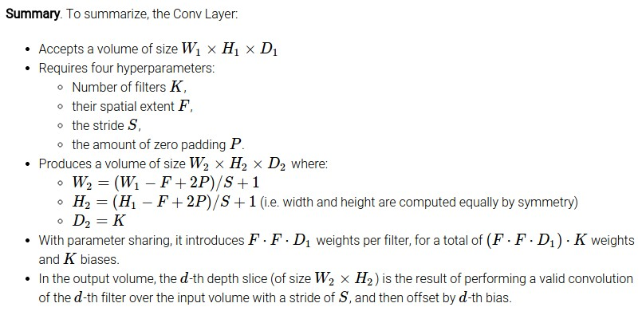

Slide 37
Common settings:
K = (powers of 2, e.g. 32, 64, 128, 512)
F = 3, S = 1, P = 1
F = 5, S = 1, P = 2
F = 5, S = 2, P = ? (whatever fits)
F = 1, S = 1, P = 0

Slide 38
(btw, 1x1 convolution layers make perfect sense)
1x1 CONV
with 32 filters
56
56
(each filter has size 1x1x64, and performs a 64-dimensional dot product)
56
56
64
32

Slide 39
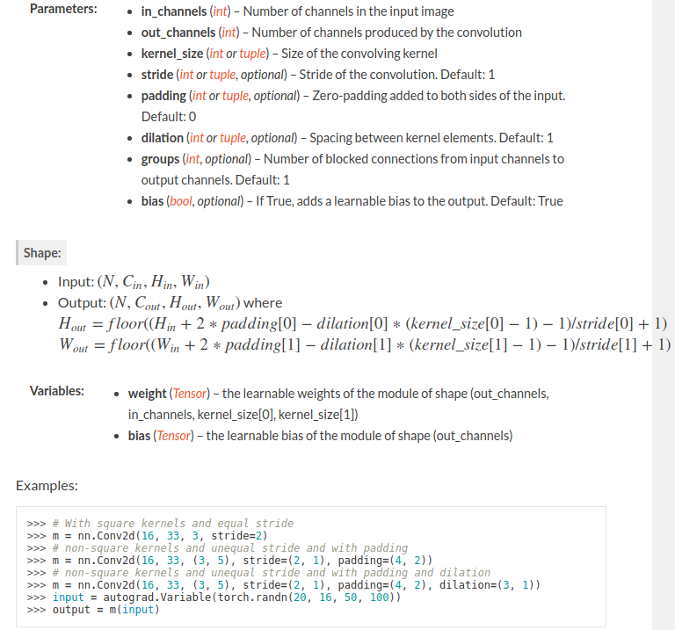
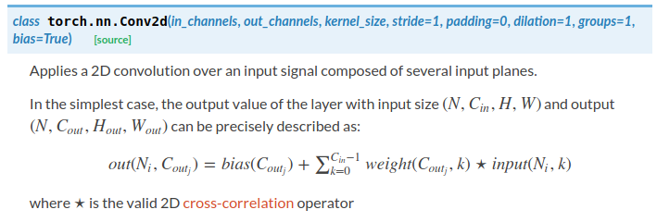
Example: nn.Conv2d in PyTorch

Slide 40
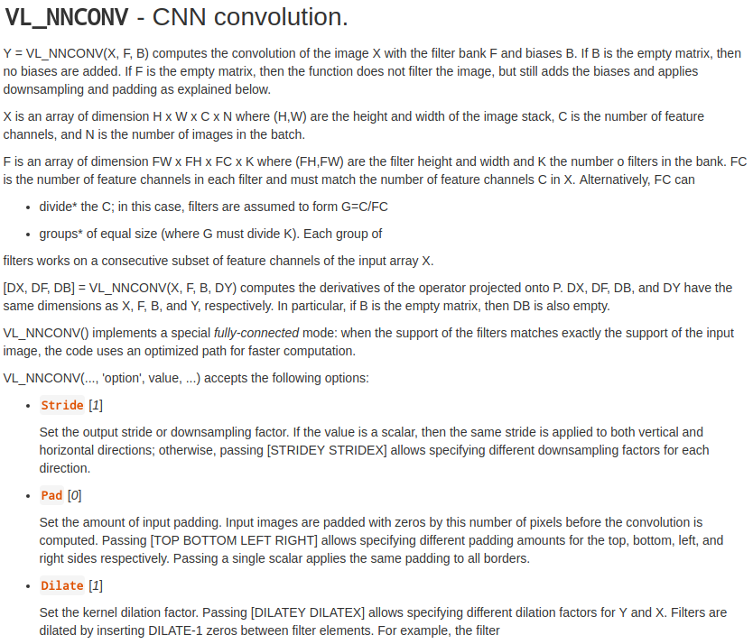
Example: vl_nnconv in MatConvNet

Slide 41
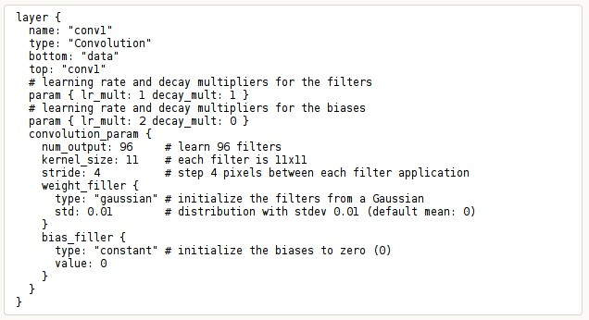
Example: Convolution in Caffe

Slide 42
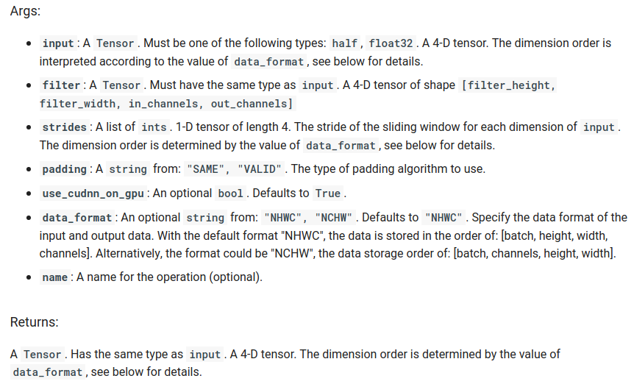
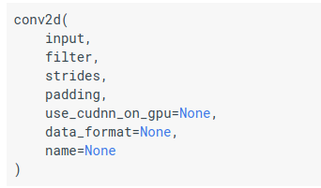
Example: tf.nn.conv2d in TensorFlow

Slide 43
The brain/neuron view of CONV Layer
32x32x3 image
5x5x3 filter
32
1 number:
the result of taking a dot product between the filter and this part of the image
(i.e. 5*5*3 = 75-dimensional dot product)
32
3

Slide 44

The brain/neuron view of CONV Layer
32x32x3 image
5x5x3 filter
32
It’s just a neuron with local connectivity...
1 number:
the result of taking a dot product between the filter and this part of the image
(i.e. 5*5*3 = 75-dimensional dot product)
32
3

Slide 45
The brain/neuron view of CONV Layer
32
28
An activation map is a 28x28 sheet of neuron outputs:
Each is connected to a small region in the input
All of them share parameters
“5x5 filter” -> “5x5 receptive field for each neuron”
A major advantage of CONV layer!
32
28
3

Slide 46
The brain/neuron view of CONV Layer
32
E.g. with 5 filters,
CONV layer consists of neurons arranged in a 3D grid
(28x28x5)
There will be 5 different neurons all looking at the same region in the input volume
28
32
28
3
5

Slide 47
two more layers to go: POOL/FC

Slide 48

Pooling layer
makes the representations smaller and more manageable
operates over each activation map independently:

Slide 49
MAX POOLING
Single depth slice
1 | 1 | 2 | 4
5 | 6 | 7 | 8
3 | 2 | 1 | 0
1 | 2 | 3 | 4
x
max pool with 2x2 filters and stride 2
6 | 8
3 | 4
y

Slide 50
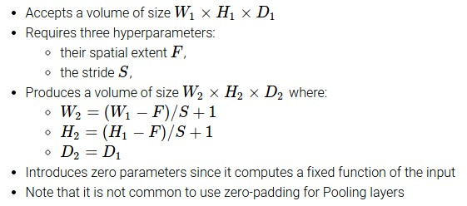

Slide 51
Common settings:
F = 2, S = 2
F = 3, S = 2

Slide 52
Why do we need pooling?
Pool information by increasing receptive field
Provide some spatial invariance

Slide 53
Fully Connected Layer (FC layer)
Contains neurons that connect to the entire input volume, as in ordinary Neural Networks

Slide 54
[ConvNetJS demo: training on CIFAR-10]
http://cs.stanford.edu/people/karpathy/convnetjs/demo/cifar10.html

Slide 55
Receptive field
Which pixels in the input image have impact on the value of v?
32
28
24
9x9
5x5
1x1
….
CONV (5x5x3),
ReLU
CONV (5x5x6),
ReLU
v
CONV,
ReLU
32
28
24
3
6
10

Slide 56
Receptive field
Which pixels in the input image have impact on the value of v?
With POOL Layers?
32
14
16x16
6x6
5
1x1
….
CONV (5x5x3),
ReLU,
POOL (2x2)
CONV (5x5x6),
ReLU,
POOL (2x2)
v
CONV,
ReLU,
POOL
5
10
32
14
3
6

Slide 57
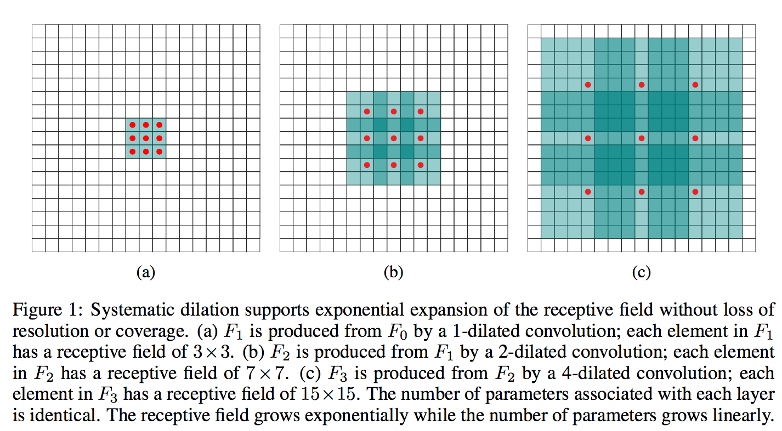
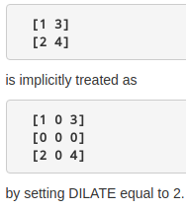
Dilated convolution, for even larger receptive fields
Multi-Scale Context Aggregation by Dilated Convolutions, Fisher Yu, Vladlen Koltun

Slide 58
Case Study: LeNet-5
[LeCun et al., 1998]
Conv filters were 5x5, applied at stride 1
Subsampling (Pooling) layers were 2x2 applied at stride 2
i.e. architecture is [CONV-POOL-CONV-POOL-FC-FC]

Slide 59
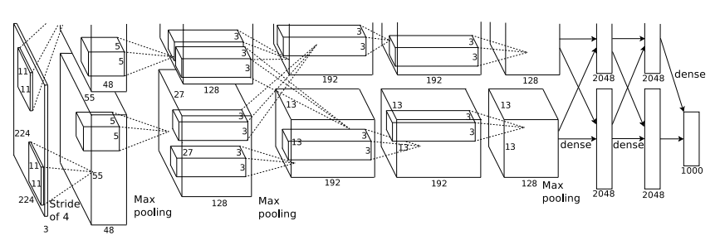
Case Study: AlexNet
[Krizhevsky et al. 2012]
Input: 227x227x3 images
First layer (CONV1): 96 11x11 filters applied at stride 4
=>
Q: what is the output volume size? Hint: (227-11)/4+1 = 55

Slide 60
Case Study: AlexNet
[Krizhevsky et al. 2012]
Input: 227x227x3 images
First layer (CONV1): 96 11x11 filters applied at stride 4
=>
Output volume [55x55x96]
Q: What is the total number of parameters in this layer?

Slide 61
Case Study: AlexNet
[Krizhevsky et al. 2012]
Input: 227x227x3 images
First layer (CONV1): 96 11x11 filters applied at stride 4
=>
Output volume [55x55x96]
Parameters: (11*11*3)*96 = 35K

Slide 62
Case Study: AlexNet
[Krizhevsky et al. 2012]
Input: 227x227x3 images
After CONV1: 55x55x96
Second layer (POOL1): 3x3 filters applied at stride 2
Q: what is the output volume size? Hint: (55-3)/2+1 = 27

Slide 63
Case Study: AlexNet
[Krizhevsky et al. 2012]
Input: 227x227x3 images
After CONV1: 55x55x96
Second layer (POOL1): 3x3 filters applied at stride 2
Output volume: 27x27x96
Q: what is the number of parameters in this layer?

Slide 64
Case Study: AlexNet
[Krizhevsky et al. 2012]
Input: 227x227x3 images
After CONV1: 55x55x96
Second layer (POOL1): 3x3 filters applied at stride 2
Output volume: 27x27x96
Parameters: 0!

Slide 65
Case Study: AlexNet
[Krizhevsky et al. 2012]
Input: 227x227x3 images
After CONV1: 55x55x96
After POOL1: 27x27x96
...

Slide 66
Case Study: AlexNet
[Krizhevsky et al. 2012]
Full (simplified) AlexNet architecture:
[227x227x3] INPUT
[55x55x96] CONV1: 96 11x11 filters at stride 4, pad 0
[27x27x96] MAX POOL1: 3x3 filters at stride 2
[27x27x96] NORM1: Normalization layer
[27x27x256] CONV2: 256 5x5 filters at stride 1, pad 2
[13x13x256] MAX POOL2: 3x3 filters at stride 2
[13x13x256] NORM2: Normalization layer
[13x13x384] CONV3: 384 3x3 filters at stride 1, pad 1
[13x13x384] CONV4: 384 3x3 filters at stride 1, pad 1
[13x13x256] CONV5: 256 3x3 filters at stride 1, pad 1
[6x6x256] MAX POOL3: 3x3 filters at stride 2
[4096] FC6: 4096 neurons
[4096] FC7: 4096 neurons
[1000] FC8: 1000 neurons (class scores)

Slide 67
Case Study: AlexNet
[Krizhevsky et al. 2012]
Full (simplified) AlexNet architecture:
[227x227x3] INPUT
[55x55x96] CONV1: 96 11x11 filters at stride 4, pad 0
[27x27x96] MAX POOL1: 3x3 filters at stride 2
[27x27x96] NORM1: Normalization layer
[27x27x256] CONV2: 256 5x5 filters at stride 1, pad 2
[13x13x256] MAX POOL2: 3x3 filters at stride 2
[13x13x256] NORM2: Normalization layer
[13x13x384] CONV3: 384 3x3 filters at stride 1, pad 1
[13x13x384] CONV4: 384 3x3 filters at stride 1, pad 1
[13x13x256] CONV5: 256 3x3 filters at stride 1, pad 1
[6x6x256] MAX POOL3: 3x3 filters at stride 2
[4096] FC6: 4096 neurons
[4096] FC7: 4096 neurons
[1000] FC8: 1000 neurons (class scores)
Details/Retrospectives:
- first use of ReLU
- used Norm layers (not common anymore)
- heavy data augmentation
- dropout 0.5
- batch size 128
- SGD Momentum 0.9
- Learning rate 1e-2, reduced by 10
manually when val accuracy plateaus
- L2 weight decay 5e-4
- 7 CNN ensemble: 18.2% -> 15.4%

Slide 68
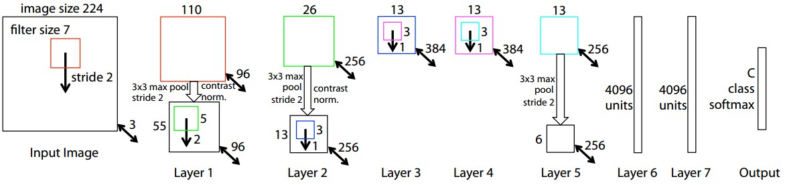
Case Study: ZFNet
[Zeiler and Fergus, 2013]
AlexNet but:
CONV1: change from (11x11 stride 4) to (7x7 stride 2)
CONV3,4,5: instead of 384, 384, 256 filters use 512, 1024, 512
ImageNet top 5 error: 15.4% -> 14.8%

Slide 69
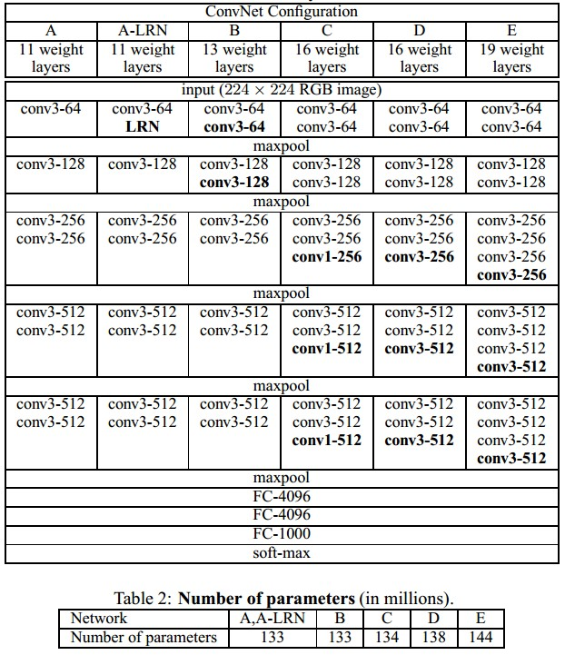
Case Study: VGGNet
[Simonyan and Zisserman, 2014]
Only 3x3 CONV stride 1, pad 1
and 2x2 MAX POOL stride 2
best model
11.2% top 5 error in ILSVRC 2013
->
7.3% top 5 error

Slide 70
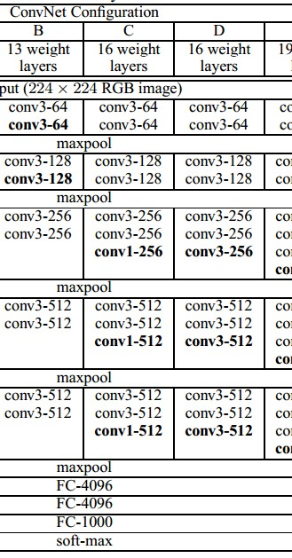
INPUT: [224x224x3] memory: 224*224*3=150K params: 0
CONV3-64: [224x224x64] memory: 224*224*64=3.2M params: (3*3*3)*64 = 1,728
CONV3-64: [224x224x64] memory: 224*224*64=3.2M params: (3*3*64)*64 = 36,864
POOL2: [112x112x64] memory: 112*112*64=800K params: 0
CONV3-128: [112x112x128] memory: 112*112*128=1.6M params: (3*3*64)*128 = 73,728
CONV3-128: [112x112x128] memory: 112*112*128=1.6M params: (3*3*128)*128 = 147,456
POOL2: [56x56x128] memory: 56*56*128=400K params: 0
CONV3-256: [56x56x256] memory: 56*56*256=800K params: (3*3*128)*256 = 294,912
CONV3-256: [56x56x256] memory: 56*56*256=800K params: (3*3*256)*256 = 589,824
CONV3-256: [56x56x256] memory: 56*56*256=800K params: (3*3*256)*256 = 589,824
POOL2: [28x28x256] memory: 28*28*256=200K params: 0
CONV3-512: [28x28x512] memory: 28*28*512=400K params: (3*3*256)*512 = 1,179,648
CONV3-512: [28x28x512] memory: 28*28*512=400K params: (3*3*512)*512 = 2,359,296
CONV3-512: [28x28x512] memory: 28*28*512=400K params: (3*3*512)*512 = 2,359,296
POOL2: [14x14x512] memory: 14*14*512=100K params: 0
CONV3-512: [14x14x512] memory: 14*14*512=100K params: (3*3*512)*512 = 2,359,296
CONV3-512: [14x14x512] memory: 14*14*512=100K params: (3*3*512)*512 = 2,359,296
CONV3-512: [14x14x512] memory: 14*14*512=100K params: (3*3*512)*512 = 2,359,296
POOL2: [7x7x512] memory: 7*7*512=25K params: 0
FC: [1x1x4096] memory: 4096 params: 7*7*512*4096 = 102,760,448
FC: [1x1x4096] memory: 4096 params: 4096*4096 = 16,777,216
FC: [1x1x1000] memory: 1000 params: 4096*1000 = 4,096,000
(not counting biases)

Slide 71
INPUT: [224x224x3] memory: 224*224*3=150K params: 0
CONV3-64: [224x224x64] memory: 224*224*64=3.2M params: (3*3*3)*64 = 1,728
CONV3-64: [224x224x64] memory: 224*224*64=3.2M params: (3*3*64)*64 = 36,864
POOL2: [112x112x64] memory: 112*112*64=800K params: 0
CONV3-128: [112x112x128] memory: 112*112*128=1.6M params: (3*3*64)*128 = 73,728
CONV3-128: [112x112x128] memory: 112*112*128=1.6M params: (3*3*128)*128 = 147,456
POOL2: [56x56x128] memory: 56*56*128=400K params: 0
CONV3-256: [56x56x256] memory: 56*56*256=800K params: (3*3*128)*256 = 294,912
CONV3-256: [56x56x256] memory: 56*56*256=800K params: (3*3*256)*256 = 589,824
CONV3-256: [56x56x256] memory: 56*56*256=800K params: (3*3*256)*256 = 589,824
POOL2: [28x28x256] memory: 28*28*256=200K params: 0
CONV3-512: [28x28x512] memory: 28*28*512=400K params: (3*3*256)*512 = 1,179,648
CONV3-512: [28x28x512] memory: 28*28*512=400K params: (3*3*512)*512 = 2,359,296
CONV3-512: [28x28x512] memory: 28*28*512=400K params: (3*3*512)*512 = 2,359,296
POOL2: [14x14x512] memory: 14*14*512=100K params: 0
CONV3-512: [14x14x512] memory: 14*14*512=100K params: (3*3*512)*512 = 2,359,296
CONV3-512: [14x14x512] memory: 14*14*512=100K params: (3*3*512)*512 = 2,359,296
CONV3-512: [14x14x512] memory: 14*14*512=100K params: (3*3*512)*512 = 2,359,296
POOL2: [7x7x512] memory: 7*7*512=25K params: 0
FC: [1x1x4096] memory: 4096 params: 7*7*512*4096 = 102,760,448
FC: [1x1x4096] memory: 4096 params: 4096*4096 = 16,777,216
FC: [1x1x1000] memory: 1000 params: 4096*1000 = 4,096,000
(not counting biases)
TOTAL memory: 24M * 4 bytes ~= 93MB / image (only forward! ~*2 for bwd)
TOTAL params: 138M parameters

Slide 72
INPUT: [224x224x3] memory: 224*224*3=150K params: 0
CONV3-64: [224x224x64] memory: 224*224*64=3.2M params: (3*3*3)*64 = 1,728
CONV3-64: [224x224x64] memory: 224*224*64=3.2M params: (3*3*64)*64 = 36,864
POOL2: [112x112x64] memory: 112*112*64=800K params: 0
CONV3-128: [112x112x128] memory: 112*112*128=1.6M params: (3*3*64)*128 = 73,728
CONV3-128: [112x112x128] memory: 112*112*128=1.6M params: (3*3*128)*128 = 147,456
POOL2: [56x56x128] memory: 56*56*128=400K params: 0
CONV3-256: [56x56x256] memory: 56*56*256=800K params: (3*3*128)*256 = 294,912
CONV3-256: [56x56x256] memory: 56*56*256=800K params: (3*3*256)*256 = 589,824
CONV3-256: [56x56x256] memory: 56*56*256=800K params: (3*3*256)*256 = 589,824
POOL2: [28x28x256] memory: 28*28*256=200K params: 0
CONV3-512: [28x28x512] memory: 28*28*512=400K params: (3*3*256)*512 = 1,179,648
CONV3-512: [28x28x512] memory: 28*28*512=400K params: (3*3*512)*512 = 2,359,296
CONV3-512: [28x28x512] memory: 28*28*512=400K params: (3*3*512)*512 = 2,359,296
POOL2: [14x14x512] memory: 14*14*512=100K params: 0
CONV3-512: [14x14x512] memory: 14*14*512=100K params: (3*3*512)*512 = 2,359,296
CONV3-512: [14x14x512] memory: 14*14*512=100K params: (3*3*512)*512 = 2,359,296
CONV3-512: [14x14x512] memory: 14*14*512=100K params: (3*3*512)*512 = 2,359,296
POOL2: [7x7x512] memory: 7*7*512=25K params: 0
FC: [1x1x4096] memory: 4096 params: 7*7*512*4096 = 102,760,448
FC: [1x1x4096] memory: 4096 params: 4096*4096 = 16,777,216
FC: [1x1x1000] memory: 1000 params: 4096*1000 = 4,096,000
(not counting biases)
Note:
Most memory is in early CONV
Most params are
in late FC
TOTAL memory: 24M * 4 bytes ~= 93MB / image (only forward! ~*2 for bwd)
TOTAL params: 138M parameters

Slide 73

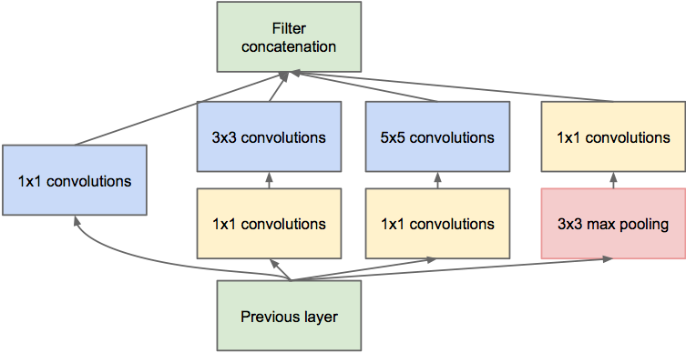
Case Study: GoogLeNet
[Szegedy et al., 2014]
Inception module
ILSVRC 2014 winner (6.7% top 5 error)

Slide 74
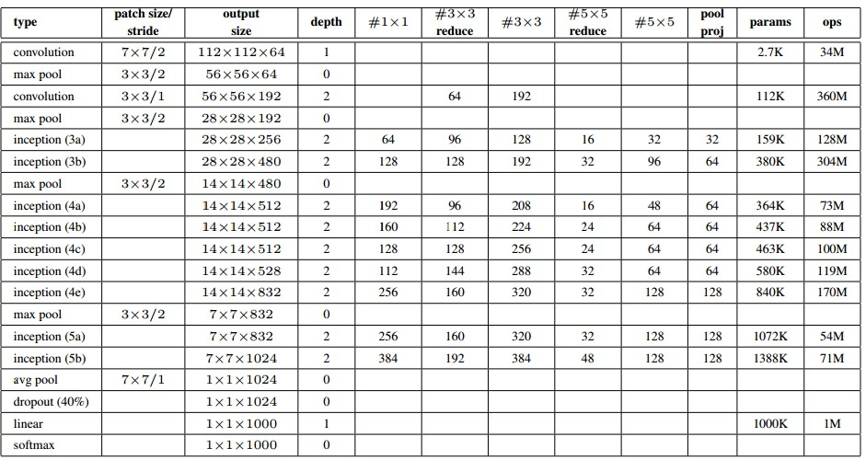
Case Study: GoogLeNet
Fun features:
- Only 5 million params!
(Removes FC layers completely)
Compared to AlexNet:
- 12X less params
- 2x more compute
- 6.67% (vs. 16.4%)

Slide 75
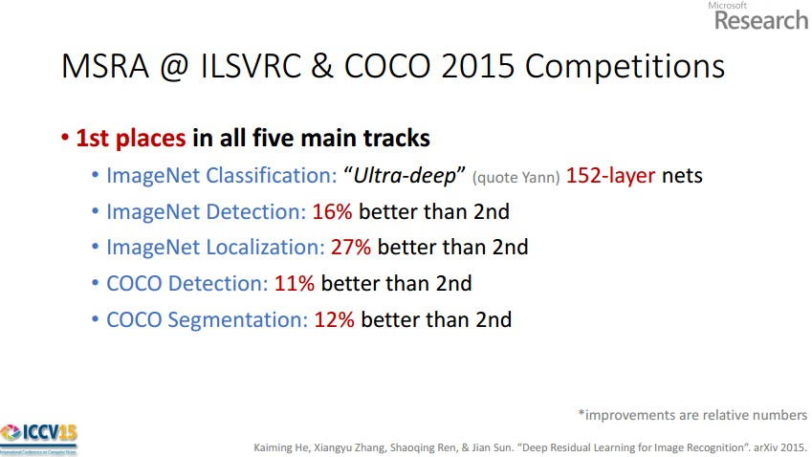

Case Study: ResNet
[He et al., 2015]
ILSVRC 2015 winner (3.6% top 5 error)
Slide from Kaiming He’s recent presentation https://www.youtube.com/watch?v=1PGLj-uKT1w

Slide 76
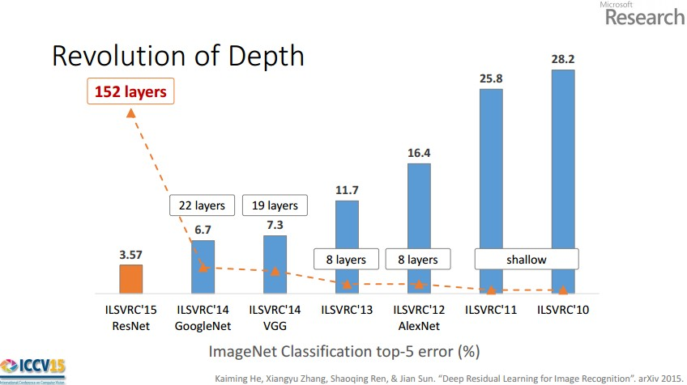
(slide from Kaiming He’s recent presentation)

Slide 77
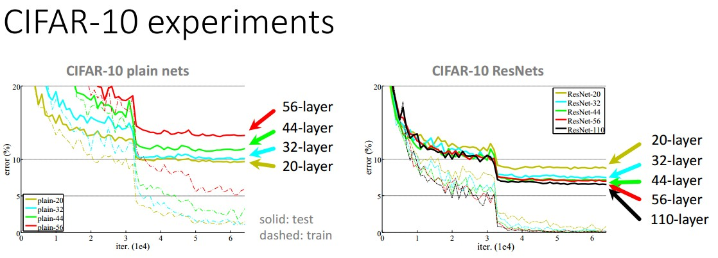

Slide 78
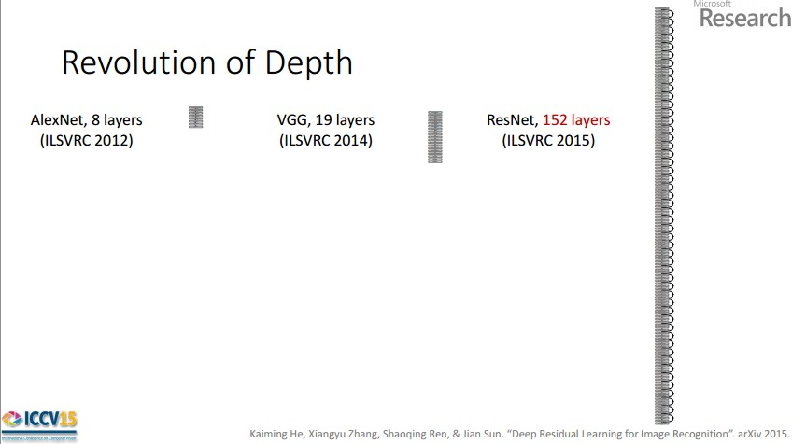
Case Study: ResNet
[He et al., 2015]
ILSVRC 2015 winner (3.6% top 5 error)
2-3 weeks of training on 8 GPU machine
at runtime: faster than a VGGNet! (even though it has 8x more layers)
(slide from Kaiming He’s recent presentation)

Slide 79
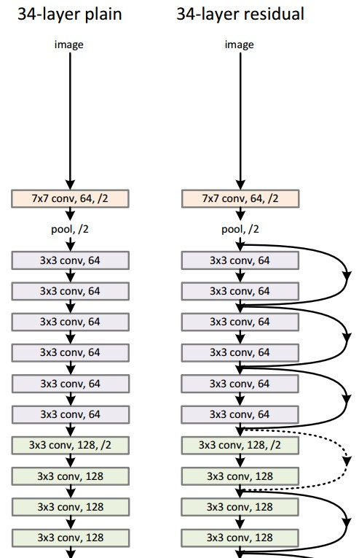
Case Study:
ResNet
224x224x3
spatial dimension only 56x56!
[He et al., 2015]

Slide 80
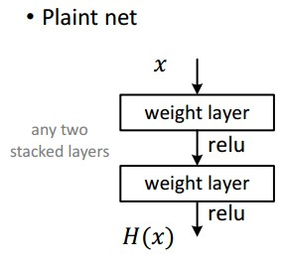
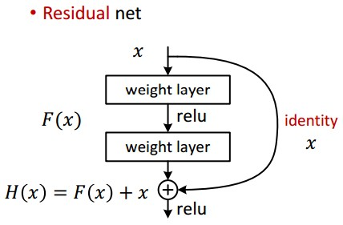
Case Study: ResNet
[He et al., 2015]

Slide 81
Case Study: ResNet
[He et al., 2015]
Batch Normalization after every CONV layer
Xavier/2 initialization from He et al.
SGD + Momentum (0.9)
Learning rate: 0.1, divided by 10 when validation error plateaus
Mini-batch size 256
Weight decay of 1e-5
No dropout used

Slide 82
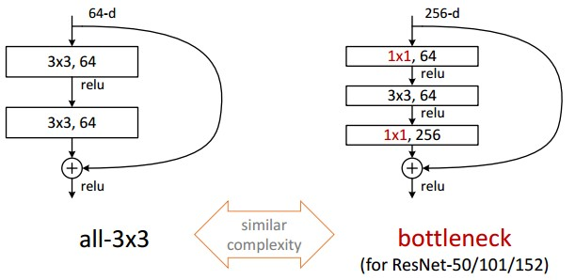
Case Study: ResNet
[He et al., 2015]

Slide 83
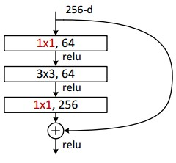
Case Study: ResNet
[He et al., 2015]
(this trick is also used in GoogLeNet)

Slide 84
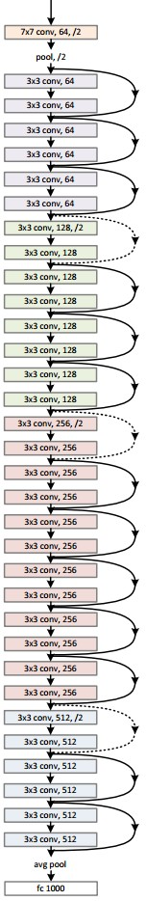
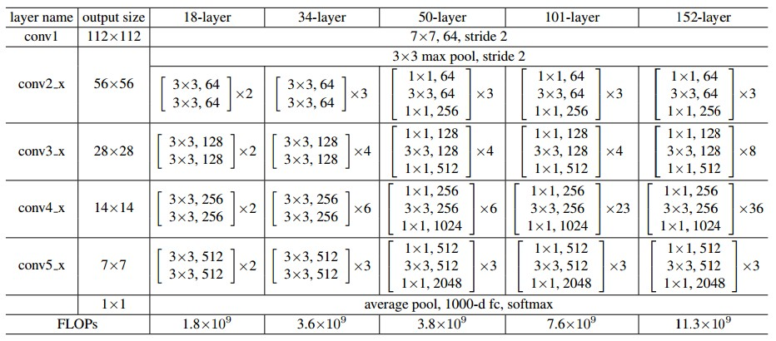
Case Study: ResNet
[He et al., 2015]

Slide 85
Summary
- ConvNets stack CONV,POOL,FC layers
- Trend towards smaller filters and deeper architectures
- Trend towards getting rid of POOL/FC layers (just CONV)
- Typical architectures look like
[(CONV-RELU)*N-POOL?]*M-(FC-RELU)*K,SOFTMAX
where N is usually up to ~5, M is large, 0 <= K <= 2.
but recent advances such as ResNet/GoogLeNet challenge this paradigm

